Slide 1

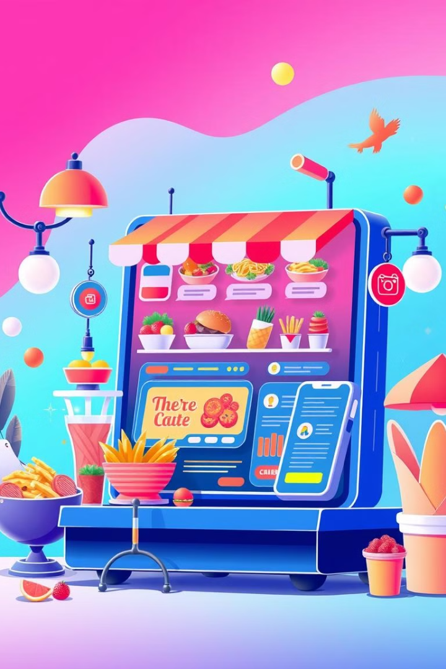

Delicious: A Food Ordering Web App
A 5th Sem Web Project by:
Dinesh Gurung
Nikesh Chaudhary
Pravat Nagarkoti

Slide 2
Introduction to "Delicious" Food Ordering System
Web-based food ordering platform with a Node.js backend and HTML + Tailwind CSS frontend.
Features: Secure user authentication, real-time food display (MongoDB), and a dynamic cart system.
AI-powered chatbot (OpenAI API) assists users with food-related queries and recommendations.
Customer feedback system displays the latest reviews on the homepage.

Slide 3
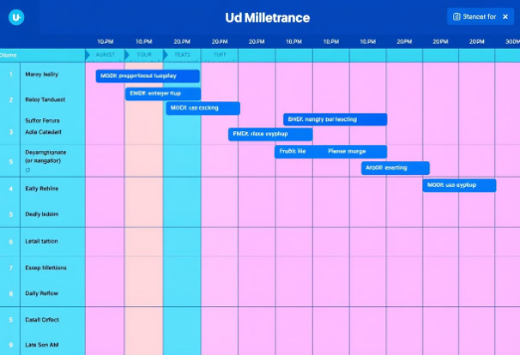
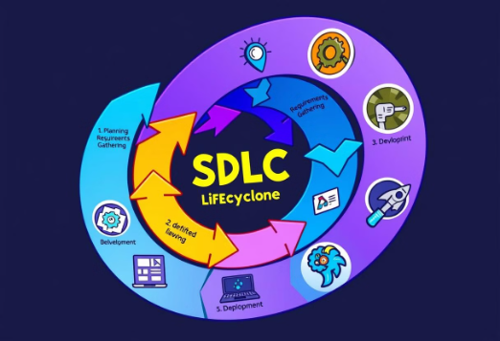
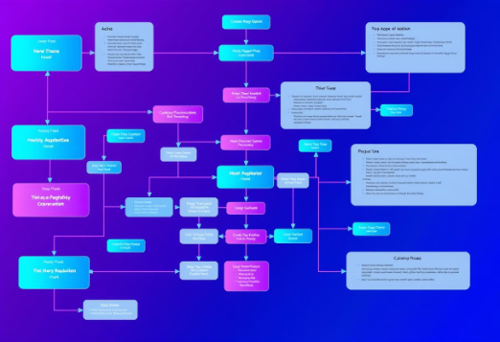
System Flow and Development
Gantt Chart
SDLC Lifecycle
Flow Chart
Illustrating project timelines and dependencies.
Mapping out the development process, from planning to deployment.
Visualizing the system flow from user interaction to delivery.

Slide 4
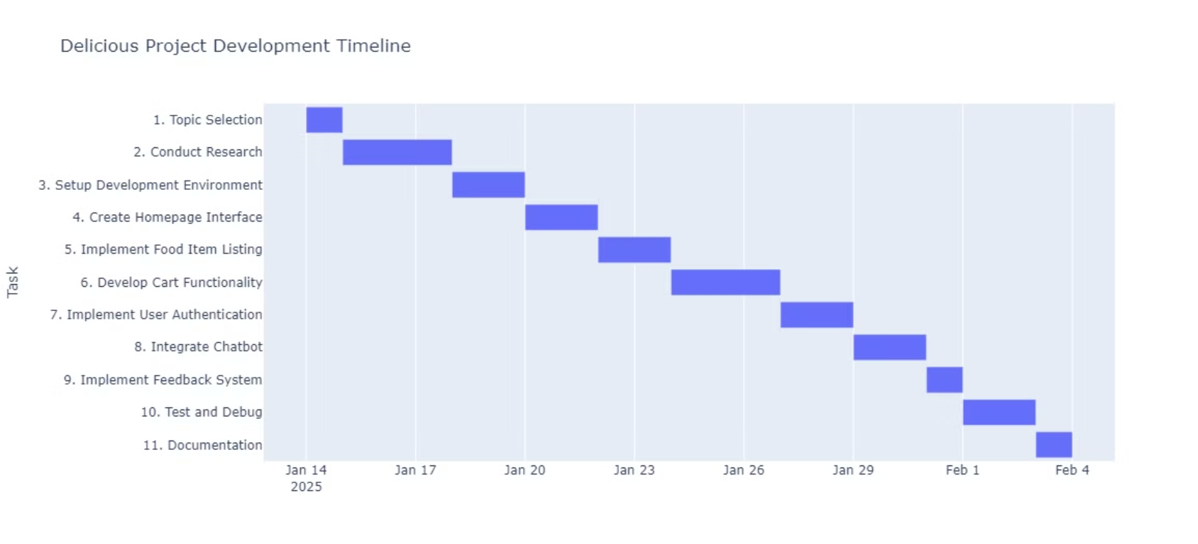
Gantt Chart

Slide 5
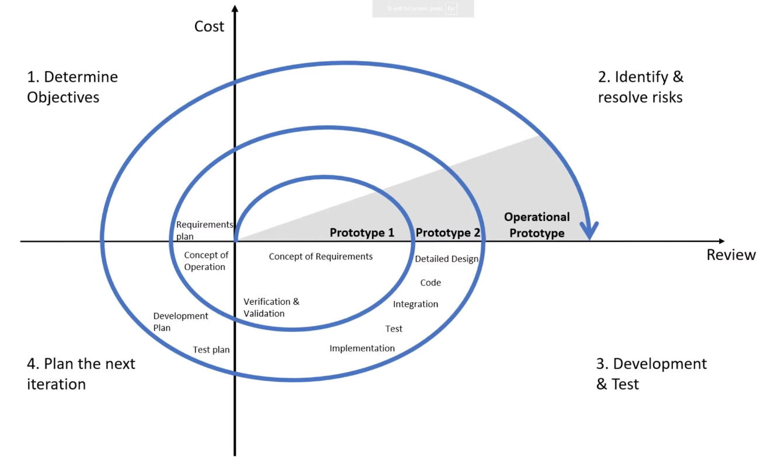
SDLC Lifecycle
Spiral Model

Slide 6

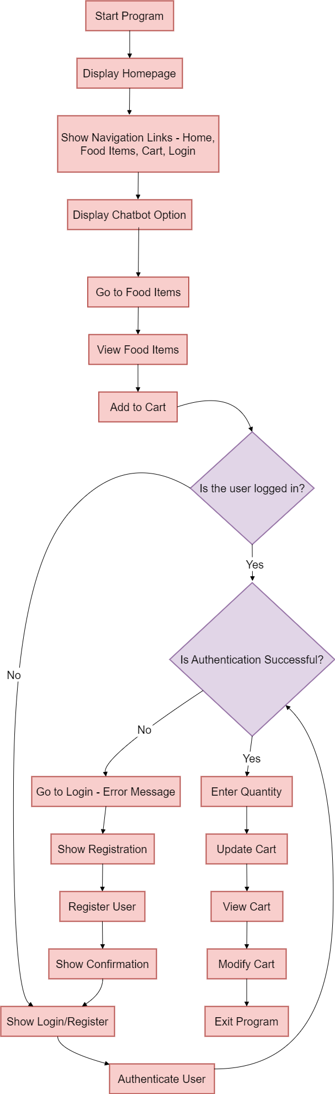
Flow Chart

Slide 7
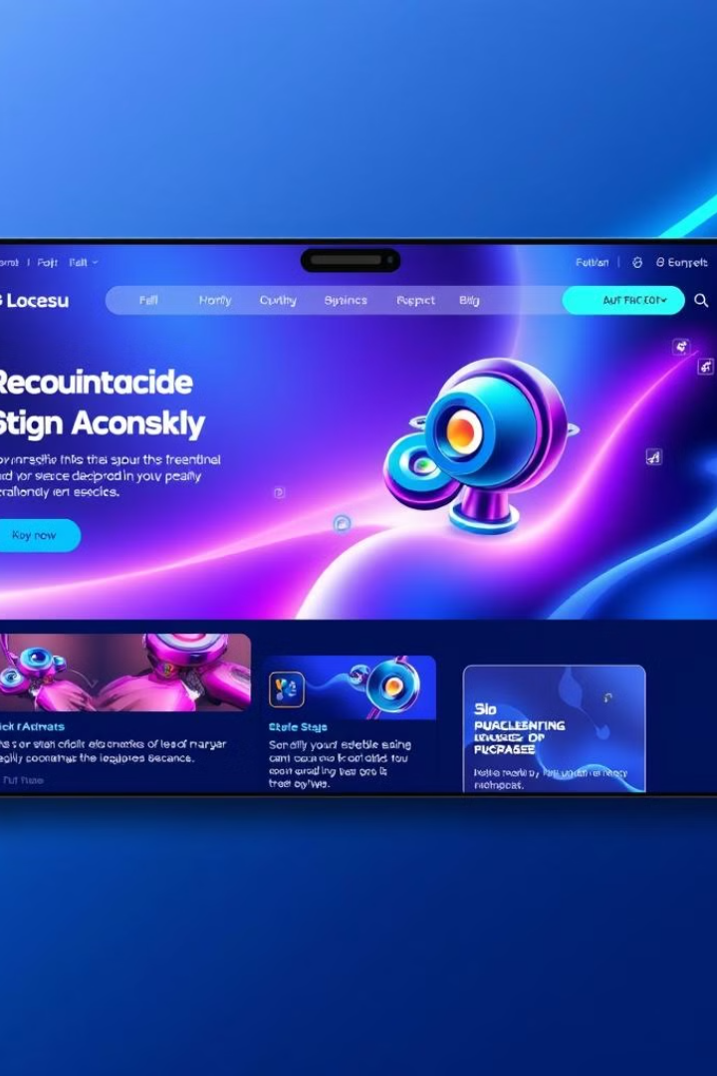
Future Enhancements
New Categories & Special Offers: Expand food options and introduce promotions.
Personalized Experience: Enable user profiles, favorite orders, and tailored recommendations.
Payment & Delivery Tracking: Integrate secure payment gateways and real-time order tracking.
Mobile App & Loyalty Rewards: Develop iOS/Android apps and introduce a points-based loyalty program.

Slide 8
Conclusion
The "Delicious" Food Ordering System successfully streamlines the online food ordering experience with secure authentication, real-time cart updates, chatbot assistance, and customer feedback integration. With a responsive design and seamless user experience, it enhances convenience for customers. Future enhancements like mobile app development, payment integration, and loyalty programs will further improve functionality and engagement. This project showcases a scalable and user-friendly solution, setting the foundation for future growth and innovation in online food services.

Slide 9

Webapp Demonstration

